Slide 1
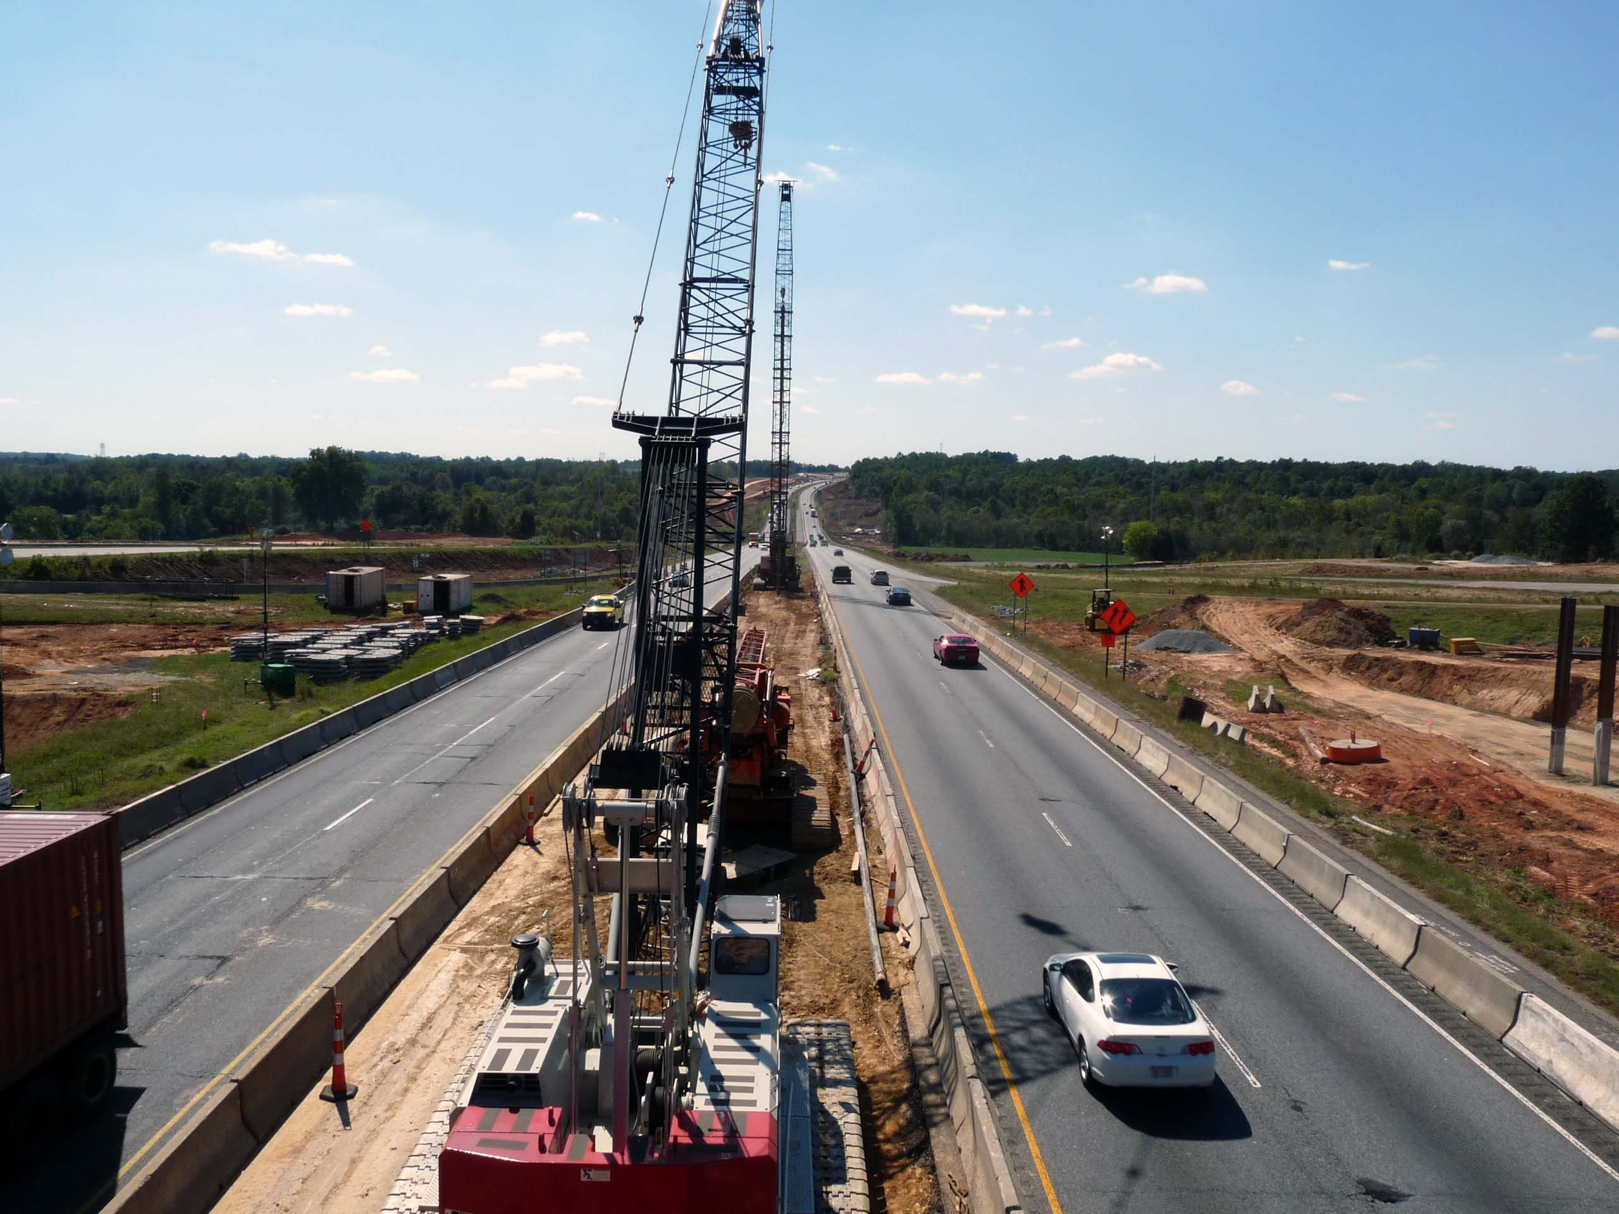
Are Investments in Roadways Worthwhile?
Virtual Annual Meeting
S O U T H E R N D I S T R I C T I T E

Slide 2
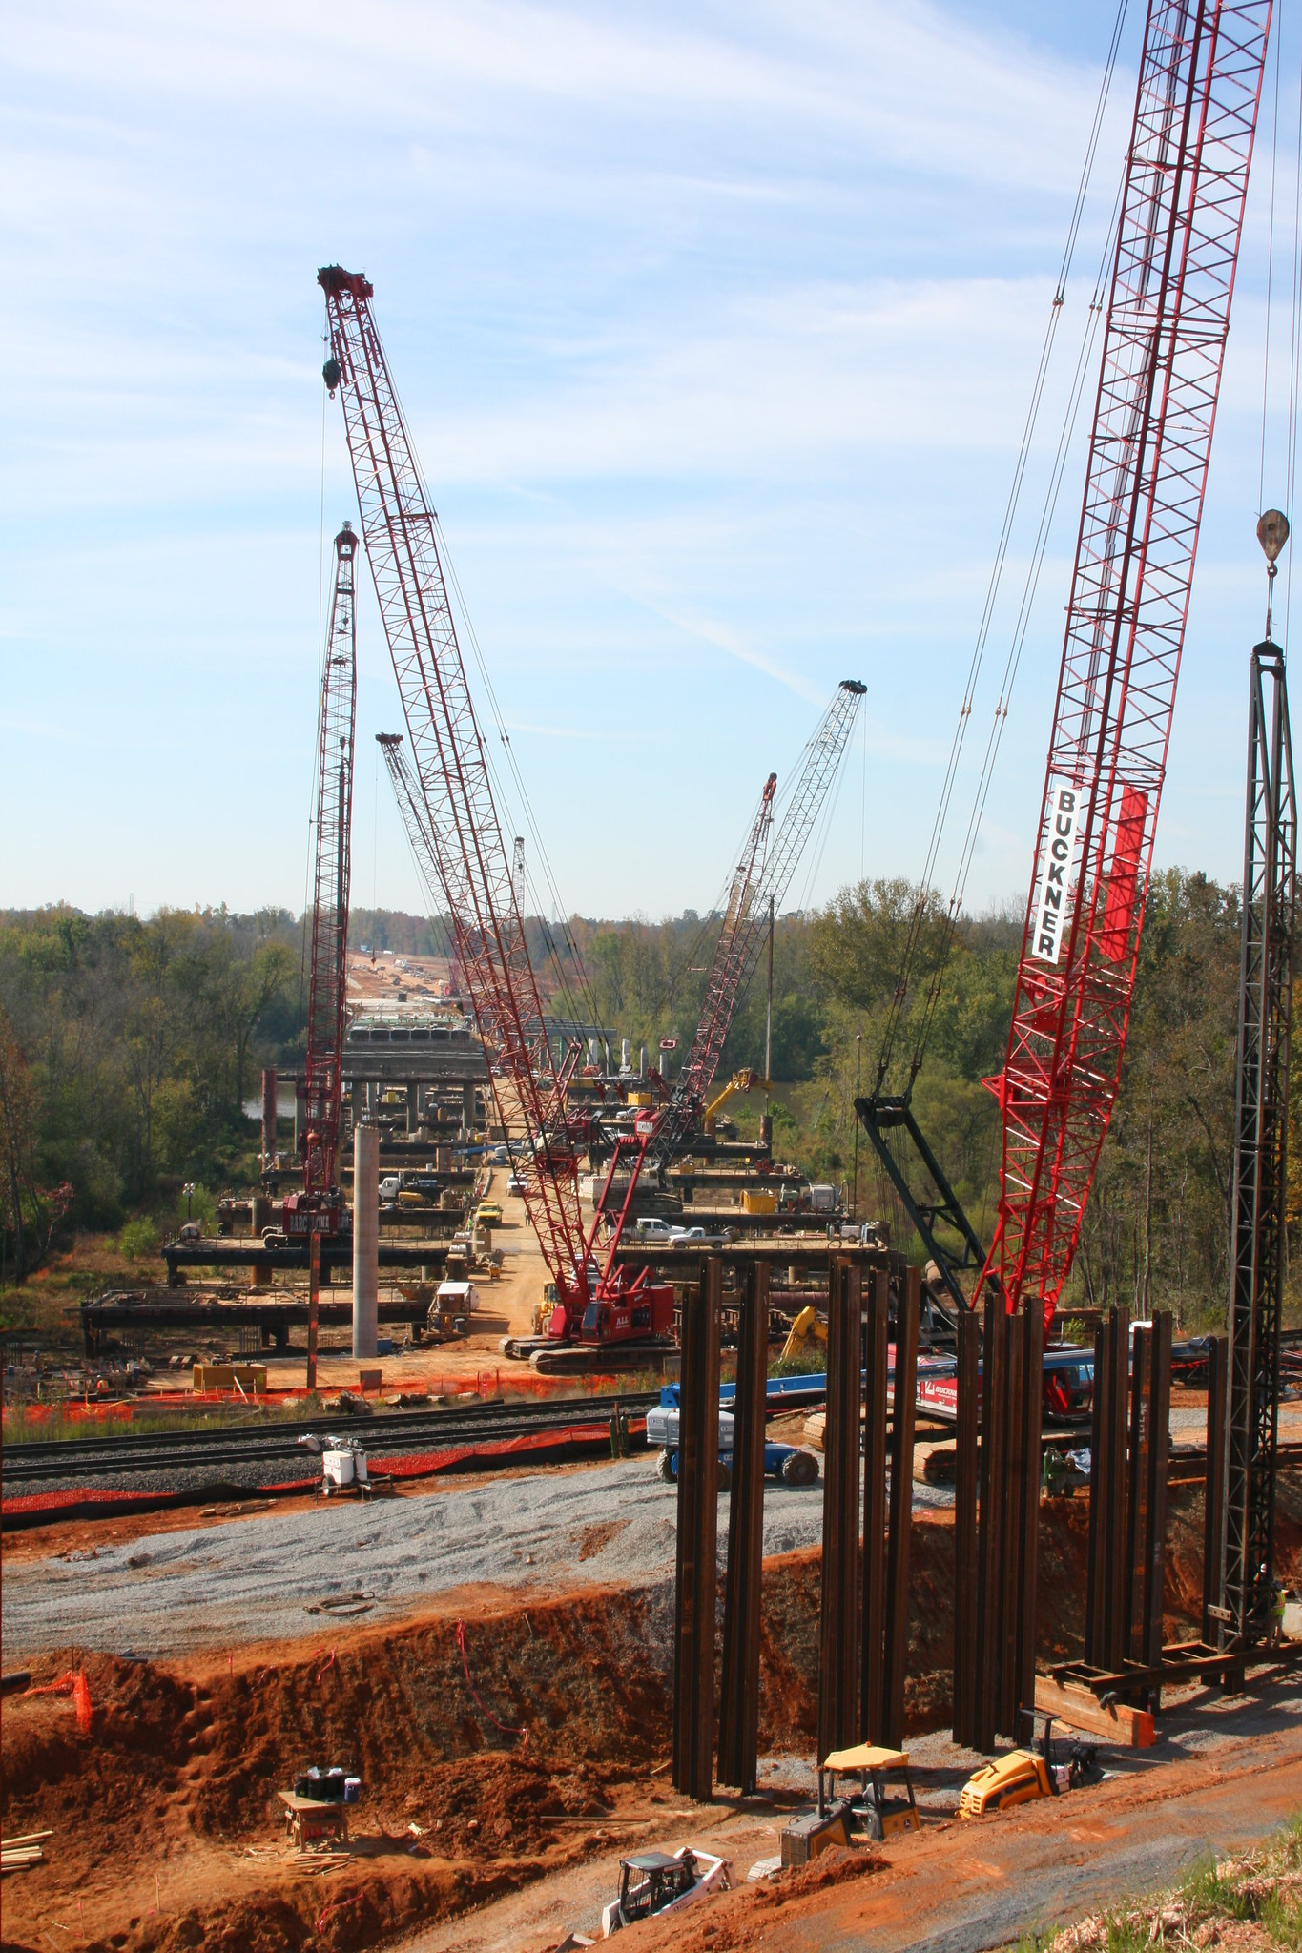
Outline
Sample of highway investments
Catalog of benefits and costs
NC roadway investment analysis
Revisit our initial question

Slide 3
Highway Investment Impacts | https://go.ncsu.edu/sdite_video

Slide 4
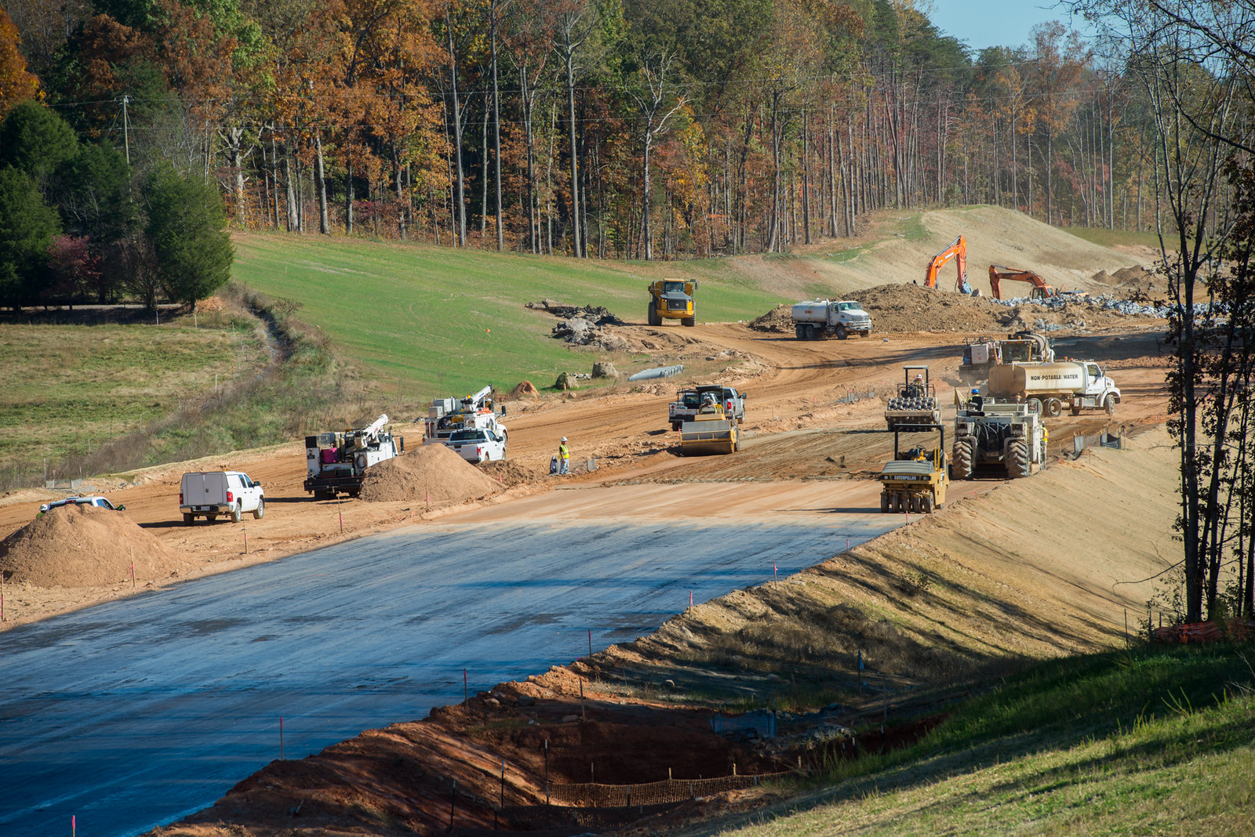
Highway Project Benefits and Costs
Economic Impacts
Employment
Earned Income
Gross Sales | Economic Output
Value Added | Gross Regional Product
Tax Revenue
External Benefits and Costs
Vehicle Cost Savings
Travel Time Cost Savings
Congestion Cost Savings
Road Traffic Noise
Vibration
Water Quality
Air Quality
Ecological Impacts
Visual Impacts
Community Severance
Water Quality
Wider Economic Impacts
Market Access (labor, delivery)
Agglomeration

Slide 5
Frameworks for Analyzing Investments
Return on Investment | Economic Efficiency Analyses
Economic Perspective: Economic Output per Dollar Invested
State Agency perspective: Tax Revenue Generated per Dollar Invested
Policy Perspective: Jobs per Dollar Invested
Benefit-Cost Analysis
Policy Perspective: Ratio of project benefits to project costs
Equity Analysis | Distributional Effects of Investment
Social Welfare Perspective: where benefits and costs are distributed and experienced

Slide 6
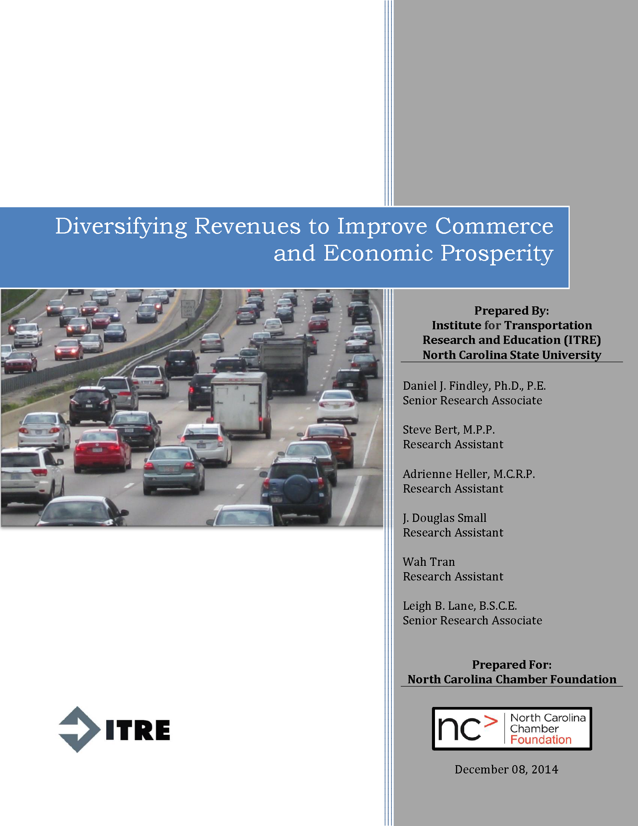
Highway Investments – Economic Analysis
Transportation funding challenges
Needed a better understanding of the economic importance of highway investment
Evaluate projects that were constructed post-2000
2015 Report
2020 Report

Slide 7
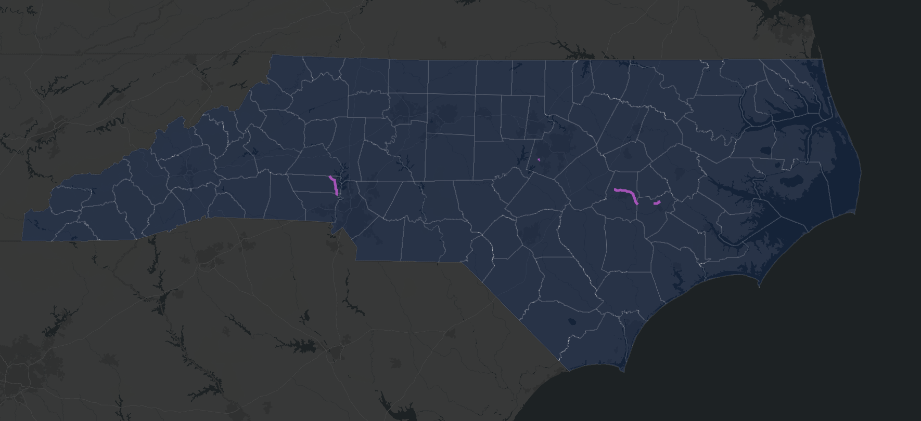
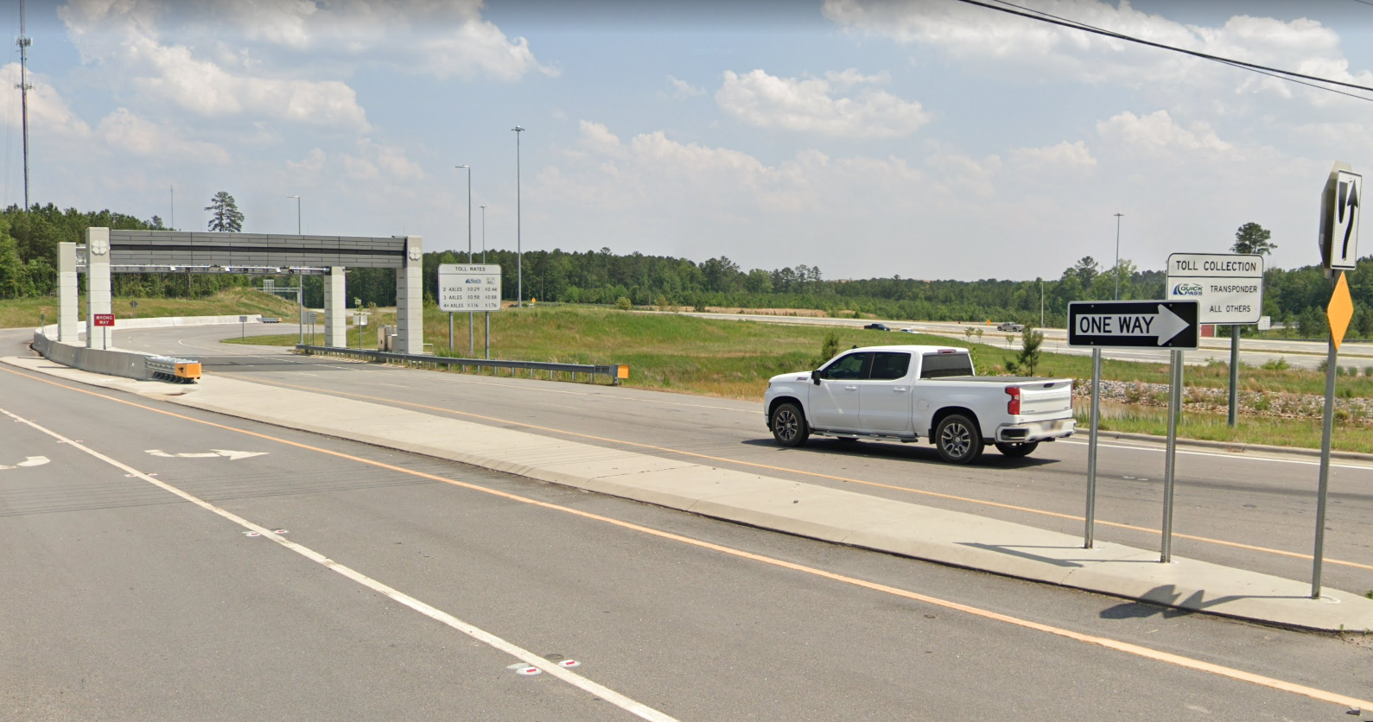
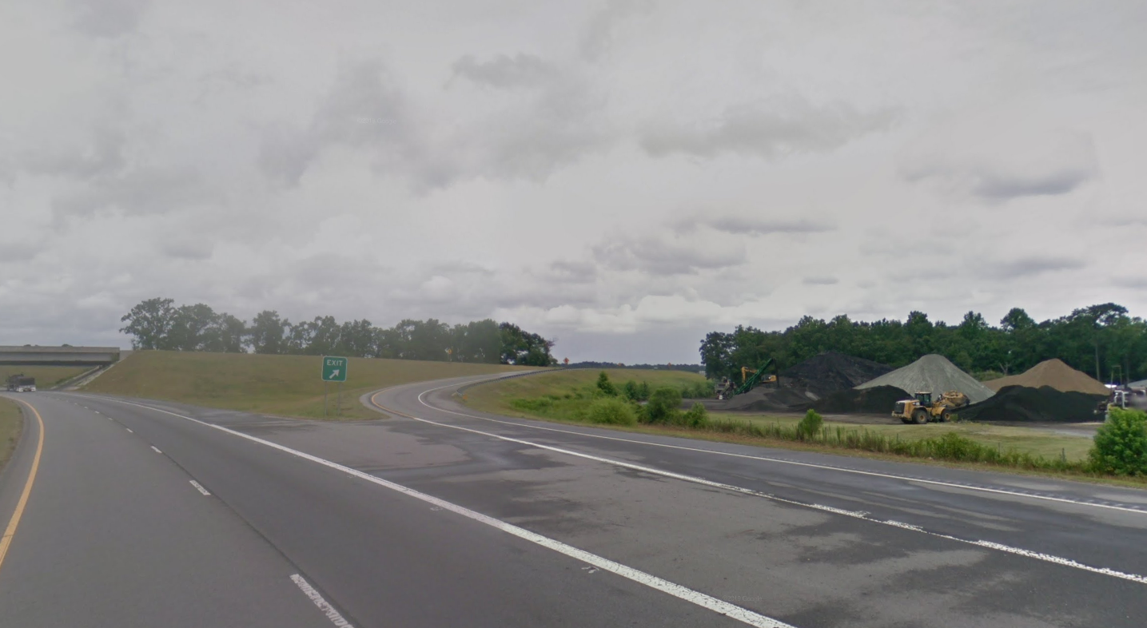
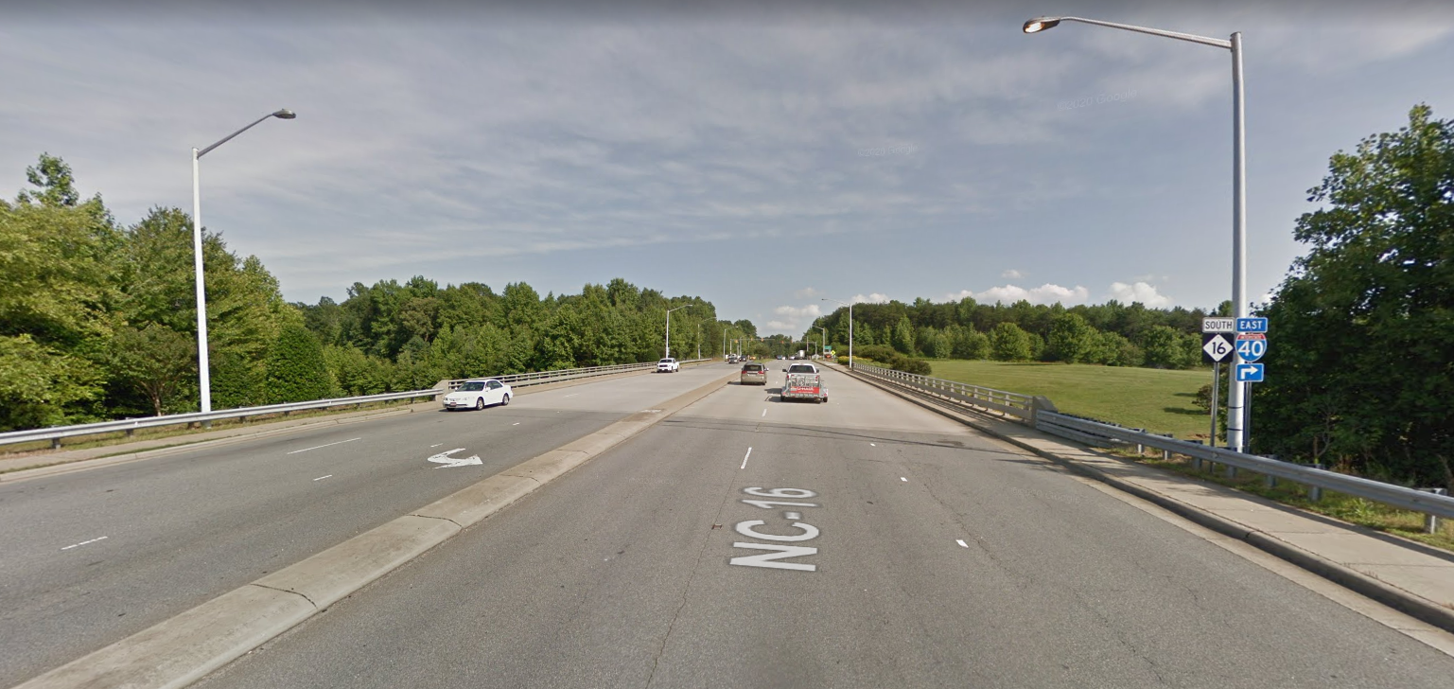
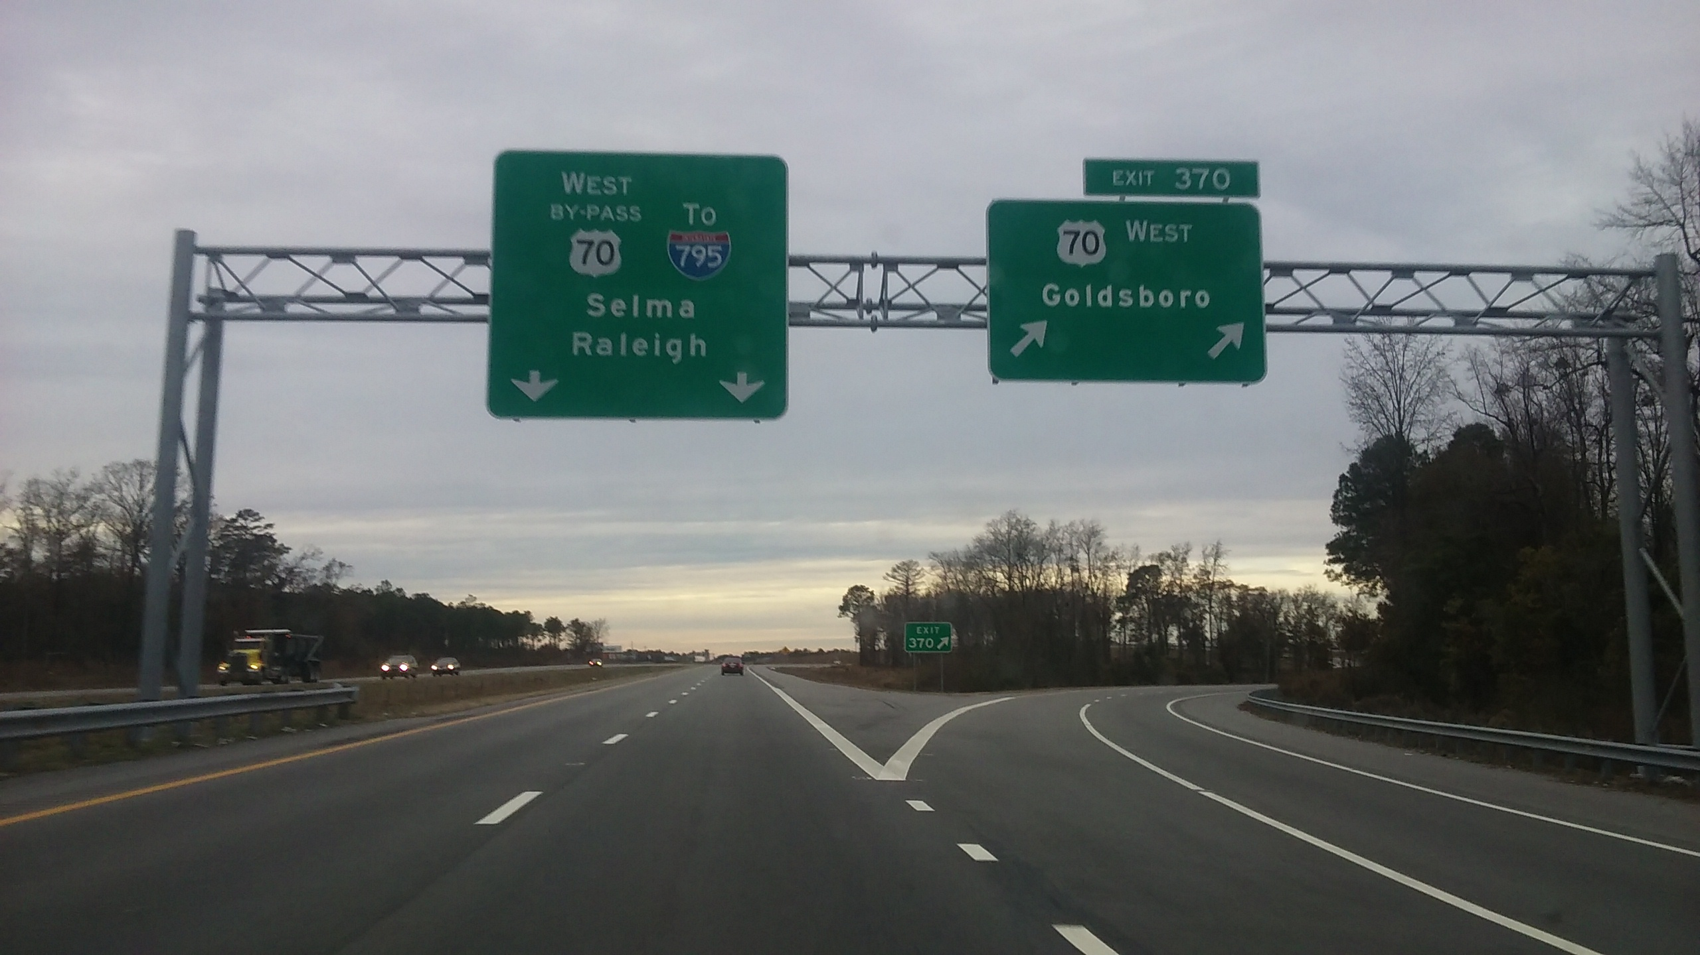
North Carolina Road Projects Analysis
I-540: Veridea Parkway Interchange
NC-148: C.F. Harvey Parkway
NC-16: Lincoln County
US-70 Goldsboro Bypass

Slide 8
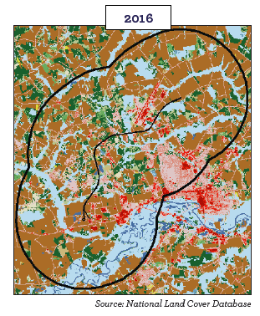
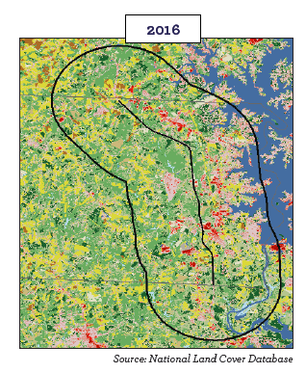
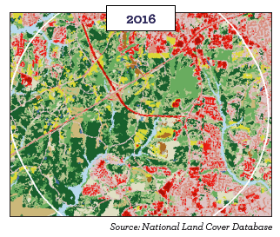
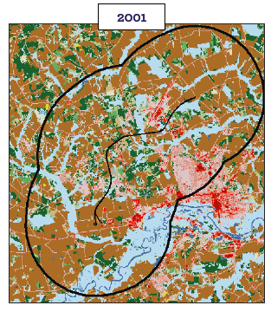
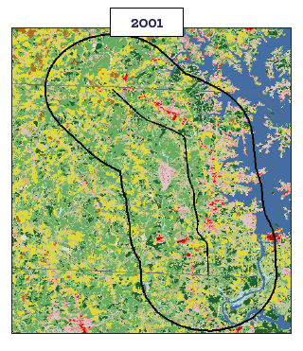
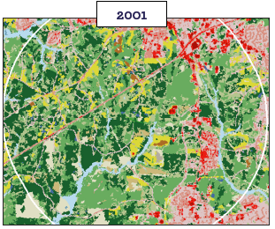
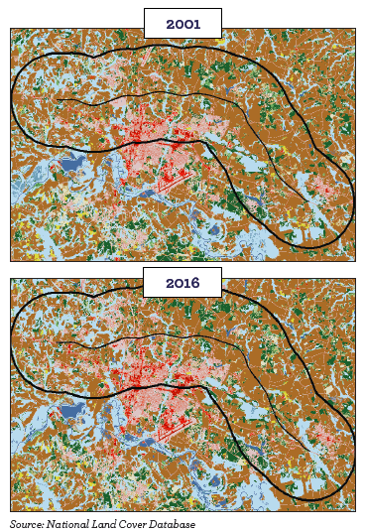
Land Use Changes | Case Studies
US-70: Goldsboro Bypass
I-540: Veridea Parkway Interchange
NC-16: Lincoln County
NC-148: C.F. Harvey Parkway*
*Reoriented for better fit (not North-South)
Road | Percent of Land Developed within 3 Miles of Project Area (2001) | Percent of Land Developed within 3 Miles of Project Area (2016) | Differential
I-540: Veridea Parkway Interchange | 23.6% | 36.1% | 12.5%
US-70: Goldsboro Bypass | 15.9% | 18.8% | 2.9%
NC-148: C.F. Harvey Parkway | 15.0% | 16.8% | 1.8%
NC-16: Lincoln County | 14.6% | 19.6% | 5.0%

Slide 9
Land Development Density | Statewide
Table 1: Square Feet of Land Development within One-Mile of Roadway
Net Change in Land Development (per mile of Road)
Road Type | Interstates | US Highways | NC Highways
Road Projects | 2,335,000 | 4,649,000 | 7,888,000
No Road Improvements | 788,000 | 496,000 | 441,000
Development Growth Intensity (Projects vs. No Improvements) | 2.97x | 9.37x | 17.89x

Slide 10
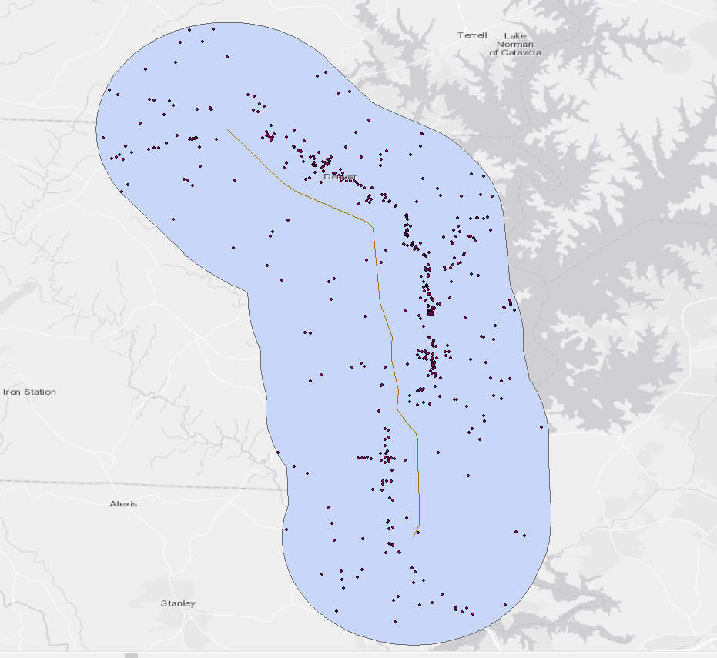
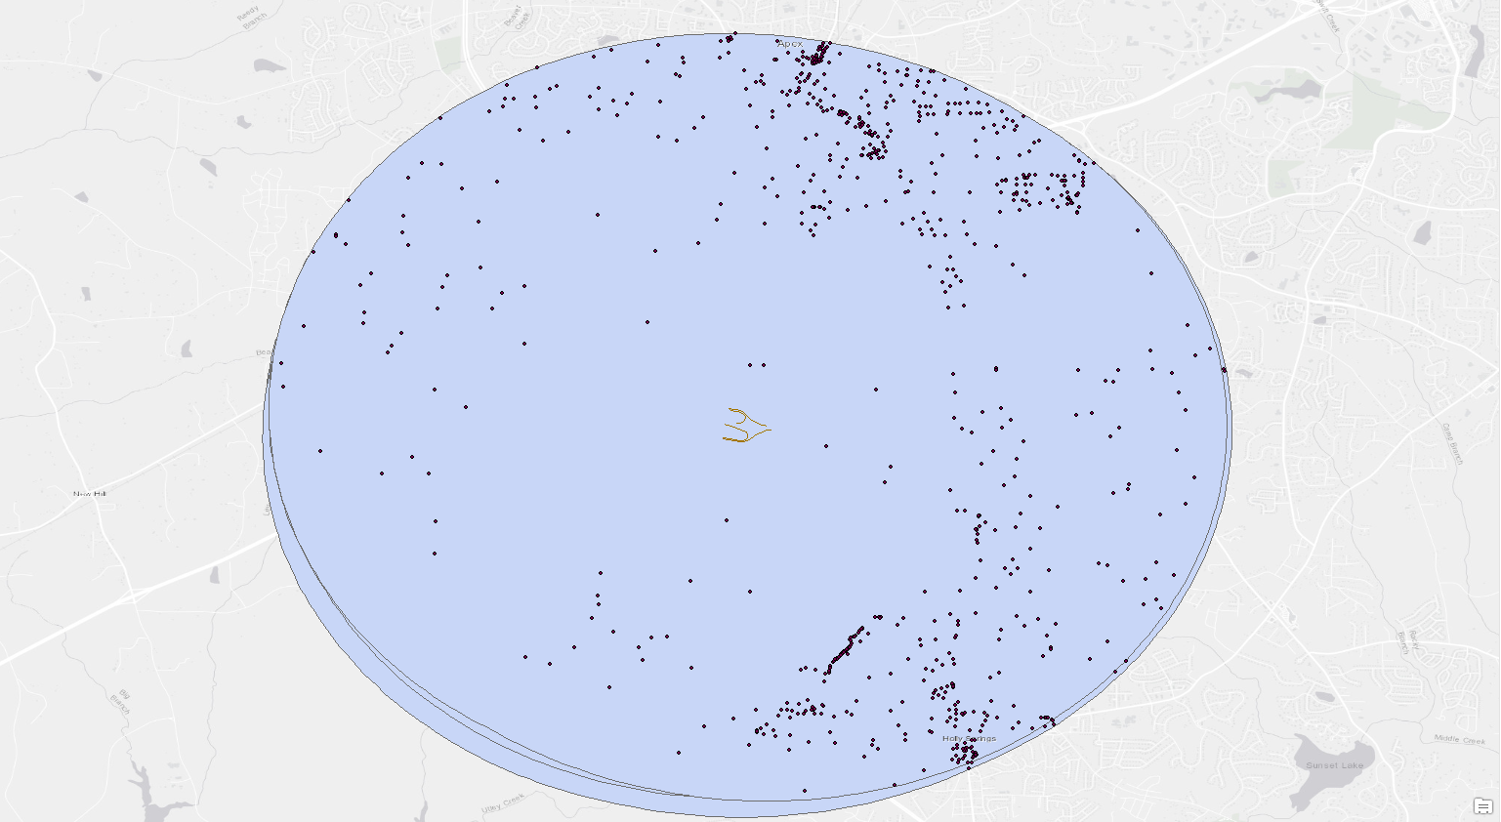
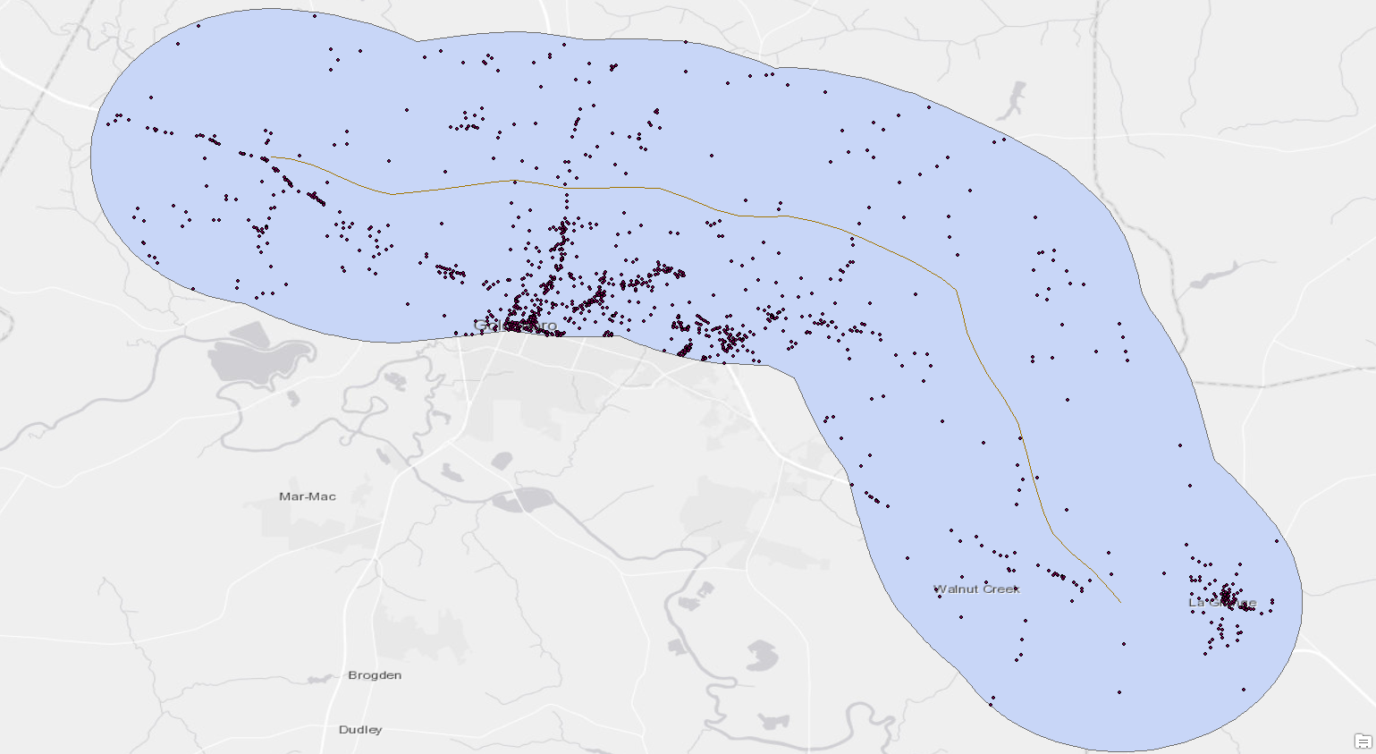
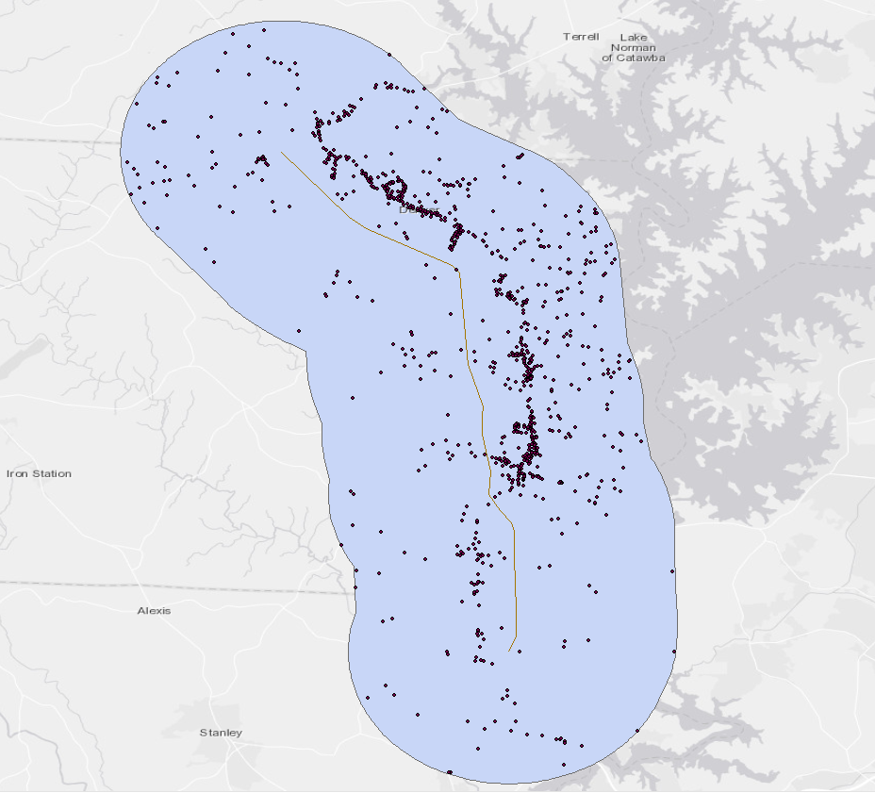
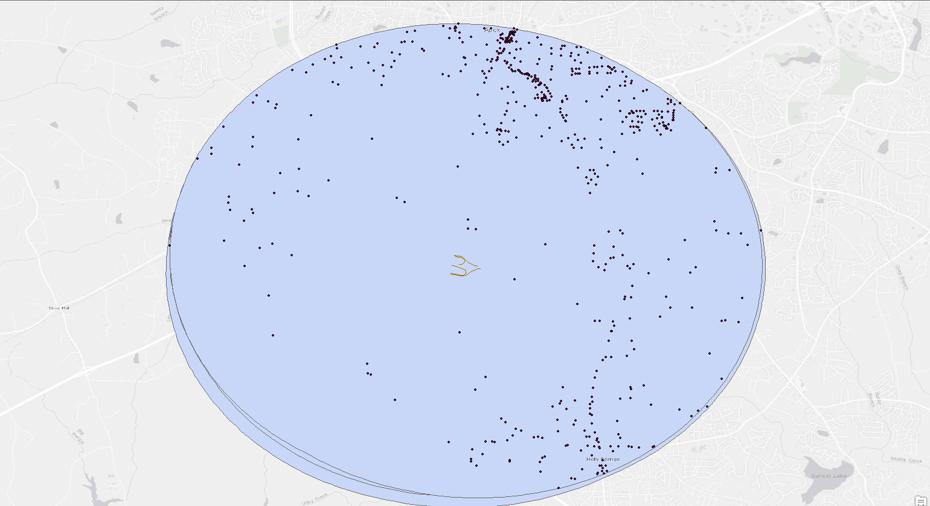
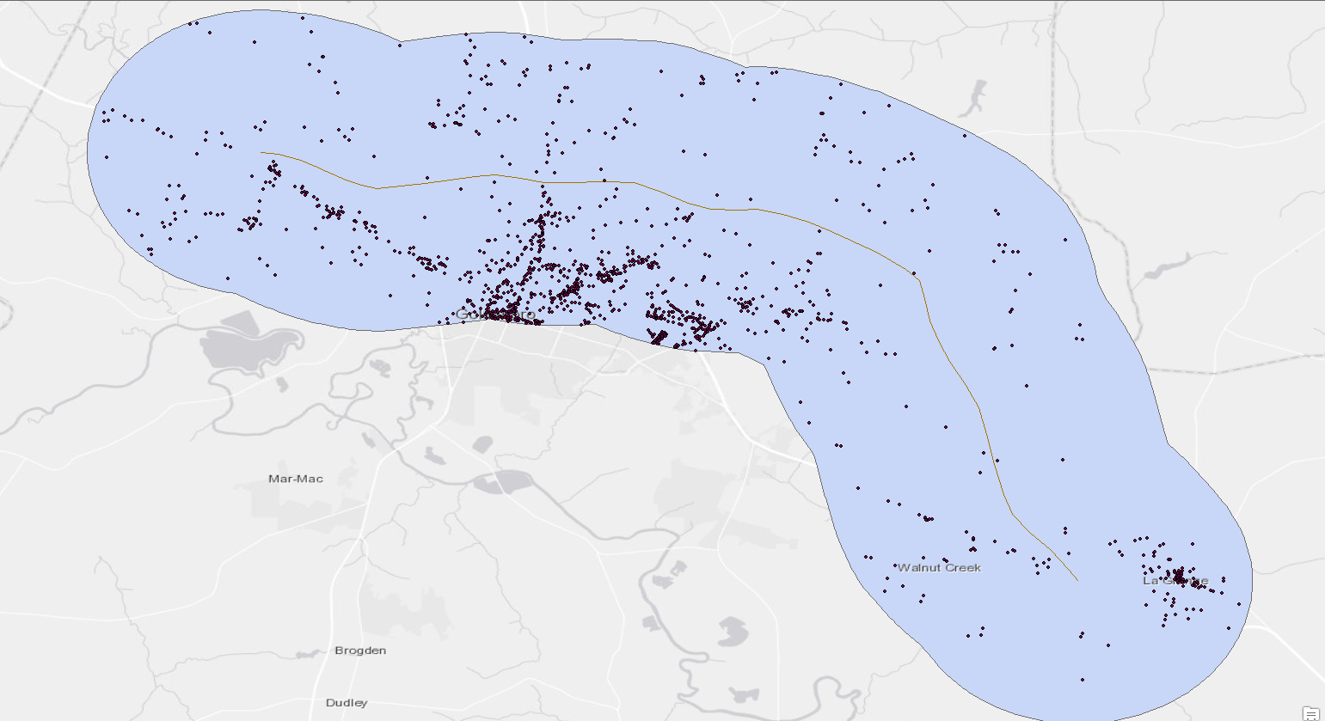
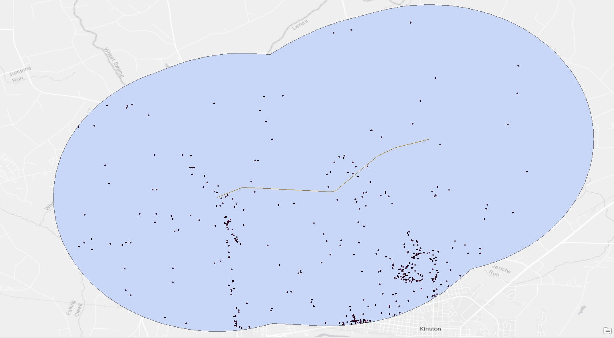
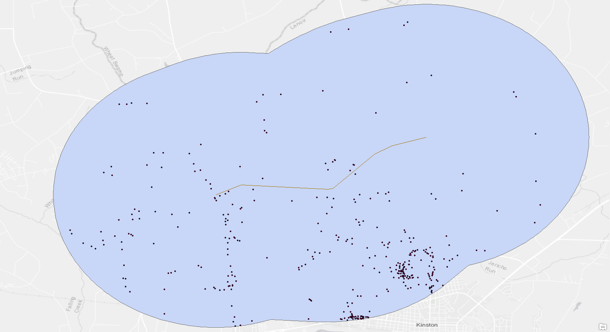
Employment Changes
2001
2018
2018
2018
2018
2008
2001
2014
I-540: Veridea Parkway Interchange
US-70: Goldsboro Bypass
NC-148: C.F.
Harvey Parkway*
NC-16: Lincoln County
*Reoriented for better fit (not North-South)
Road | Jobs Before Road Project Within 3 miles of Project Area | Jobs in 2018 Within 3 miles of Project Area | Percent Increase
I-540: Veridea Parkway Interchange | 11,800 (in 2014) | 12,700 | 7.6%
US-70: Goldsboro Bypass | 29,700 (in 2008) | 33,200 | 11.7%
NC-148: C.F. Harvey Parkway | 13,700 (in 2001) | 14,800 | 8.0%
NC-16: Lincoln County | 5,735 (in 2001) | 10,618 | 85.1%

Slide 11
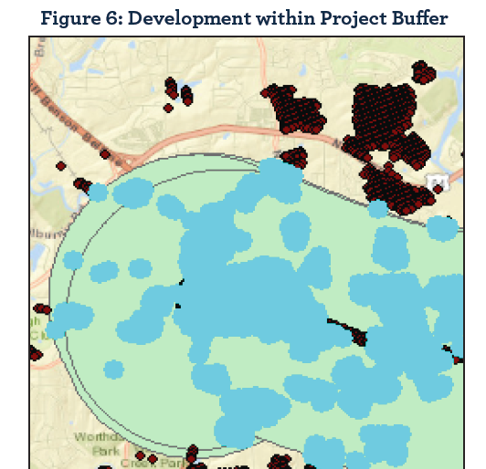
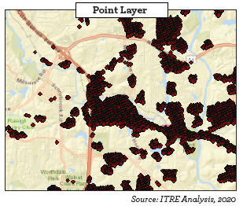
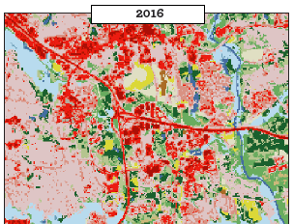
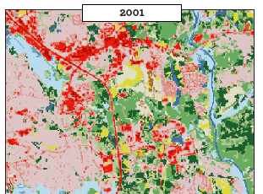
Economic Importance of Infrastructure Investment
Development within Project Buffer
Table 1: Change in Number of Businesses within One-Mile of Roadway
Table 2: Change in Employment within One-Mile of Roadway
Road Type | 2001 | 2016 | Percent Change
Interstates (Road Projects) | 3,560 | 6,050 | 69%
Interstates (No Road Projects) | 79,700 | 113,700 | 42%
Difference in Growth Rates Between Interstates with and without Improvements |  |  | 27%
US Highways (Road Projects) | 17,250 | 24,250 | 41%
US Highways ( No Road Projects) | 185,000 | 236,400 | 28%
Difference in Growth Rates Between US Highways with and without Improvements |  |  | 13%
NC Highways (Road Projects) | 15,950 | 27,520 | 73%
NC Highways ( No Road Projects) | 165,100 | 205,900 | 25%
Difference in Growth Rates Between NC Highways with and without Improvements |  |  | 48%
Road Type | 2001 | 2016 | Percent Change
Interstates (Road Projects) | 47,700 | 84,100 | 76%
Interstates (No Road Projects) | 1,096,000 | 1,418,000 | 29%
Difference in Growth Rates Between Interstates with and without Improvements |  |  | 47%
US Highways (Road Projects) | 195,000 | 251,400 | 29%
US Highways ( No Road Projects) | 2,119,000 | 2,555,000 | 21%
Difference in Growth Rates Between US Highways with and without Improvements |  |  | 8%
NC Highways (Road Projects) | 231,000 | 313,000 | 35%
NC Highways ( No Road Projects) | 1,786,000 | 2,122,000 | 19%
Difference in Growth Rates Between NC Highways with and without Improvements |  |  | 16%
Notes:
New roads create valuable real estate for commercial businesses, provide the necessary infrastructure and connection for industry, and connect commuters with access to further employment centers, prompting residential development.
All of these types of development create jobs, economic contributions, and tax revenues for the region where the road is located.
Historical data demonstrates that every $1 billion of transportation investment in North Carolina supports 14,300 jobs, $10.3 billion in wages, and $10.8 billion in gross state product (ITRE, 2015).
For this research, our team developed a methodology to quantify the development surrounding road projects that occurred within the state of North Carolina over the time period of 2001 to 2016 and compared that to the development surrounding roads that had not been built or improved over that time period.
To do this, the research team used Land use and business data to identify the increase in number of businesses, jobs, and square footage of development within one mile of road projects.
(Click through animations on slide)
This first image shows the land use in 2001 followed by an image from 2016 which shows the connecting interchange between I-440 and I-87 along with the I-87 corridor.
The next image shows us the differences between these two time periods and the final image shows us a one-mile buffer around the project (which is probably a conservative estimate of the impacts of the project).
Comparing road segments with a project within the time period of 2001 to 2016 to road segments without projects, roads with projects experienced an additional percent increase of development and firm and jobs growth over the 15-year time period. For example, locations within proximity to NC highway road projects experienced 16 percent more job growth than other NC highways that were not improved. Similarly, the values for interstates was 47% and was 8% for US highways.

Slide 12
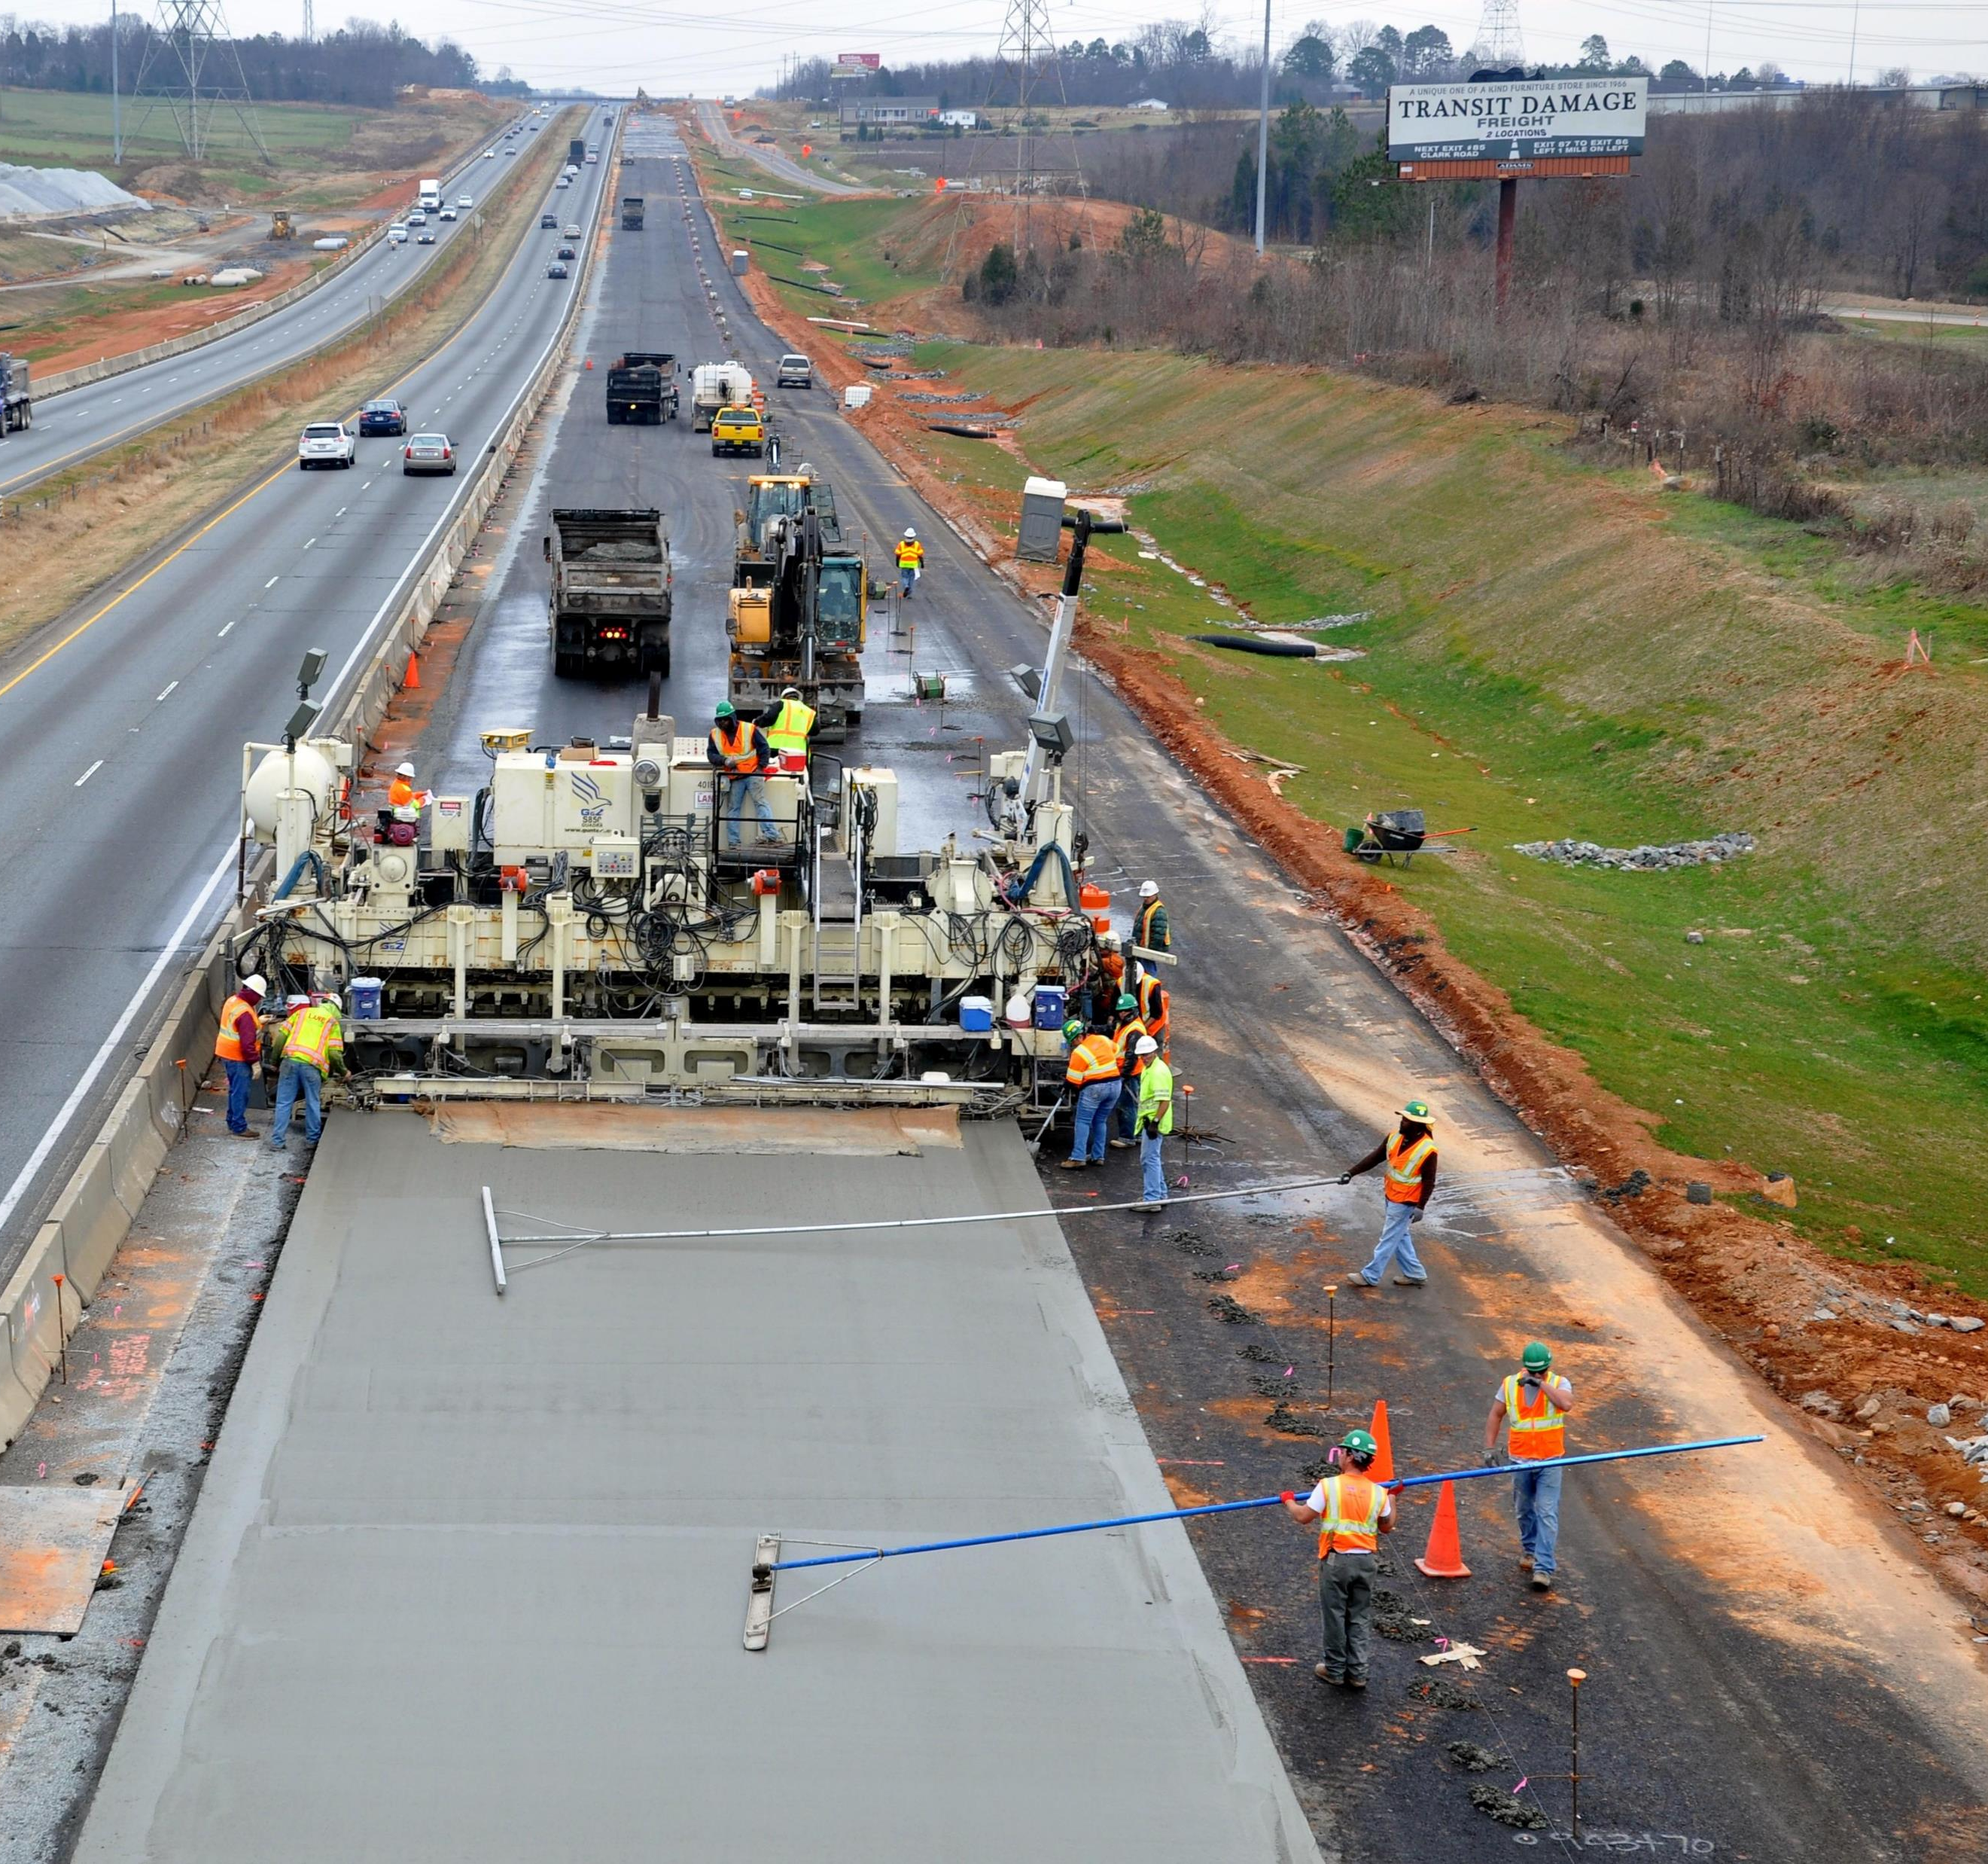
Summary of Study Findings
Significant economic impacts after infrastructure investment. From 2001 to 2016:
Job growth grew by 76 percent at firms located within one-mile of an interstate project | Compared to 42 percent growth at locations within one-mile of an interstate that was not improved
Locations within proximity to NC highway projects experienced a 35 percent increase in employment | Compared to 19 percent growth at locations within one-mile of an NC highway that was not improved
Notes:
I’m going to start off by setting the stage for what you’re going to hear in the upcoming slides – I’m kind of stealing my own thunder, but I want you to look for these themes as we move through this presentation
First, we documented that State and local communities quickly realize significant economic benefits after infrastructure investment
From 2001 to 2016, locations within proximity to NC highway projects experienced a 35 percent increase in employment, 16 percent more than other NC highways that were not improved
Next, we further explored and summarized the transportation funding environment and showed that North Carolina’s existing motor fuels tax does not yield sufficient revenue to meet growing infrastructure demand
Finally, we present a case that revenue diversification is critical to fund the necessary transportation operation, maintenance, and modernization projects

Slide 13
Are Investments in Road Projects Worthwhile?
Economic evidence from North Carolina and across the United States
Benefit-cost analyses required by USDOT
Equity-analyses are just starting to emerge in mainstream transportation economics
Depends on the Evaluation Framework
Return on Investment
Benefit-Cost Analysis
Equity Analysis
Economic Impacts
Employment
Earned Income
Gross Sales | Economic Output
Value Added | Gross Regional Product
Tax Revenue
External Benefits and Costs
How are benefits and costs distributed?
Vehicle Cost Savings
Travel Time Cost Savings
Congestion Cost Savings
Road Traffic Noise
Vibration
Water Quality
Air Quality
Ecological Impacts
Visual Impacts
Community Severance
Water Quality
Wider Economic Impacts
Market Access (labor, delivery)
Agglomeration

Slide 14
Thank You!
Research Team
Daniel Findley, Ph.D., P.E.
Weston Head, M.S.
Nicolas Norboge, Ph.D.
Stephen Odom, B.S.
Lindsey Dorn,
Steven Bert, M.A., AICP
stevebert@ncsu.edu

